Slide 1

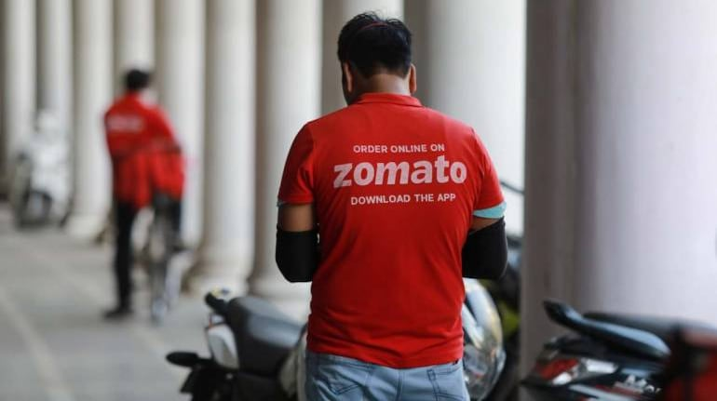
ZOMATO ANALYSIS

Slide 2
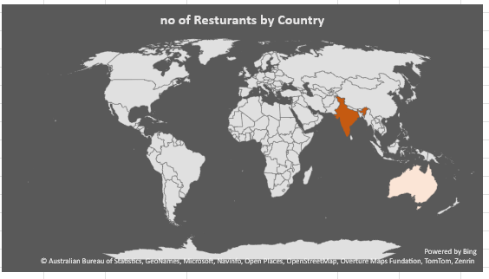
Build a country Map Table
A Country Map Table is one of the most commonly used tools, for data analysis or reviewing business performance, to systematically arrange and illustrate and compare important metrics between different countries. It also can be used as one KPI to track and evaluate a number of aspects related to international performance, including sales numbers, market share, customer satisfaction, or any other important metric for any given country.

Slide 3
Concatenates the Year and Month in the format YYYY-MMM
Year Extracts the year from the Datekey
Month no Extracts the month number
Month Full Name Extracts the full name of the month
Quarter Assigns a quarter (Q1, Q2, Q3, or Q4) based on the month number.
Year-Month Concatenates the year and month in the format YYYY-MM
Weekday no Extracts the weekday number
Weekday name Extracts the weekday name
Financial Month Maps month to financial month
Financial Quarter Assign a financial quarter

Slide 4
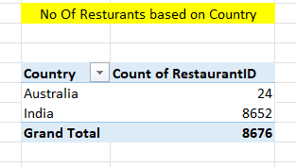
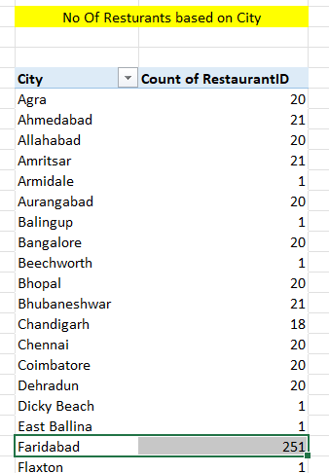
3.Find the Numbers of Restaurants based on City and Country
To calculate the number of restaurants based on City and Country, you need to aggregate the restaurant data based on the location. Typically, you would use SQL, Power BI, or other data analysis tools to group your data by City and Country and then count the number of unique restaurant entries for each combination.

Slide 5
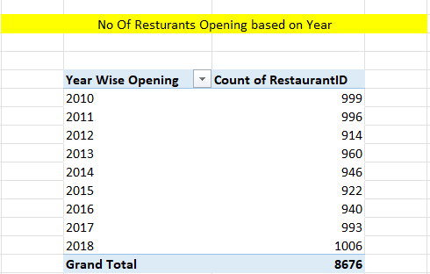

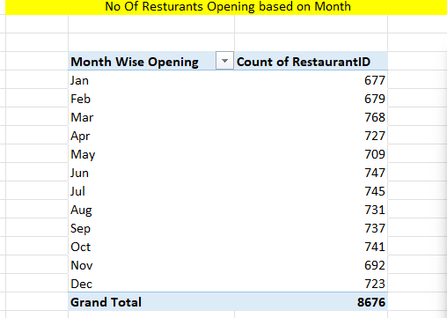
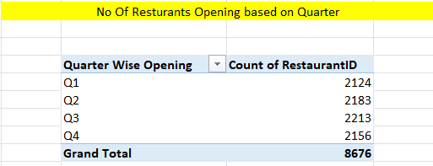
4.Numbers of Restaurants opening based on Year , Quarter , Month
Tracking the opening number of restaurants by year, quarter, or month to a Zomato analysis would be important in indicating food and beverage industry trends. Data can be of significant use to stakeholders in order to make informed decisions regarding the dynamics of the market, the competition, customer preferences, and other opportunities for growth.

Slide 6
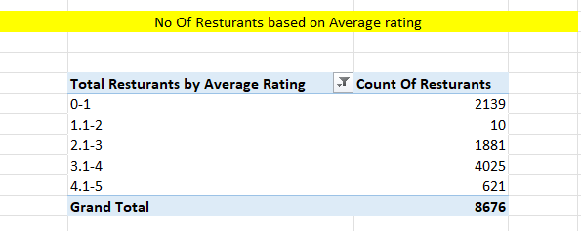
5. Count of Restaurants based on Average Ratings
Count of restaurants by average rating is such a KPI that would facilitate the gaining of insights over the overall quality and different levels of customer satisfaction in restaurants, especially on platforms such as Zomato. This KPI categorizes restaurants into groups based upon average ratings provided by the users/customers after they dine and gives insights to the distribution of restaurant quality.

Slide 7
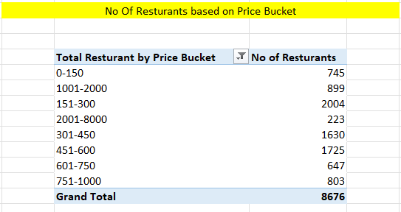
6. Create buckets based on Average Price of reasonable size and find out how many restaurants falls in each buckets
Creating buckets by average price of restaurants would be a good way to segment restaurants into different buckets based on their pricing. This would give Zomato the distribution of restaurants across various price ranges and would be helpful in making market and customer preference insights clearer.
Average price bucket KPI refers to putting restaurants into specific pricing categories, or "buckets," and then counting how many restaurants fall into each category. This analysis allows businesses, restaurant owners, and Zomato to evaluate the pricing distribution, identify market opportunities, and make data-driven decisions.

Slide 8
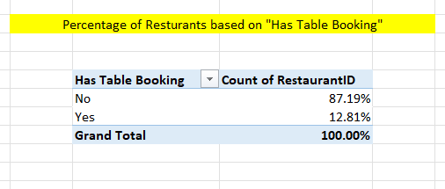
7.Percentage of Restaurants based on "Has_Table_booking"
Has_Table_Booking is the KPI of restaurants in Zomato, which enables a customer to book a table. This means restaurants which can book a table on the Zomato platform. It is an important metric for deciding how many restaurants are catering to the demand for reservation and how that would influence customer behavior, restaurant performance, and the overall offering by Zomato.

Slide 9
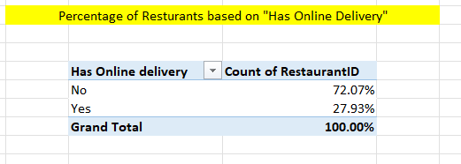
8.Percentage of Restaurants based on "Has_Online_delivery"
The "Has_Online_Delivery" KPI in Zomato is the percentage of restaurants that provide online delivery. This KPI is vital in understanding how many restaurants are adopting the growing trend of food delivery, particularly through platforms like Zomato itself and other delivery services. This metric helps in analyzing the penetration of the delivery model across the restaurant industry and provides insights into customer preferences, operational strategies, and market trends.

Slide 10
9. Develop Charts based on Cuisines, City, Ratings
Graphical representations emerging from the analysis of cuisines, cities, and ratings in Zomato help develop highly effective means to represent and derive insights about restaurant markets, consumer preferences, and efficiency of operations. The KPIs assist Zomato to track trends related to restaurants, identify deficits, and make decisions with the data considering improvements in the experience for the users and optimized recommendation for restaurants.

Slide 11

This Photo by Unknown Author is licensed under CC BY-SA

